Slide 1
CUSTOMISED DISCOUNT PREDICTION
Team Members:
Ravi Ghadia
Shubham Maheshwari
Arpit Dwivedi
Team Name: Buccaneers

Slide 2

PROBLEM STATEMENT
Develop an intelligent and efficient model to recommend customized discounts for customers based on their business significance
To predict the individual components of Total Discount viz. On-Invoice Discount and Off-Invoice Discount
To identify the anomalous data points from the given data and recommend appropriate discounts for them
Create a user interface that is convenient for the end user

Slide 3

APPROACH
To predict the discounts we first use a classifier to predict whether the customer is eligible for a discount or not
For an eligible customer, we then predict the discount values using a regressor
Thus we use a total of 4 models; 2 each for On-Invoice and Off-Invoice discount predictions
We have primarily used two models: CatBoost and LightGBM, due to their inherent ability to handle categorical features

Slide 4
FLOW DIAGRAM OF THE MODEL
0
On-Invoice Classifier
On-Invoice Discount
1
On-Invoice Regressor
Dataset
Total Discount
0
Off-Invoice Classifier
Off-Invoice Discount
1
Off-Invoice Regressor

Slide 5
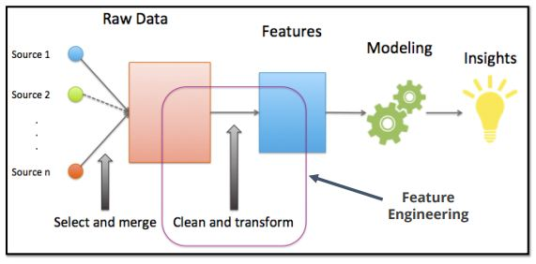
FEATURE ADDITION
Cost before tax:- Since GTO_2019 is the cost after tax, it was only natural to introduce a new feature that presents information about the product's original price
Tax percent:- This feature helps to understand the variation of taxation across different product sets and provinces
Delta Volume:- This feature helps to understand the rise/drop in sales of each product set at a given POC
Unit price before/after tax:- This is the price per unit volume without/with taxes
On/Off-Invoice Discount percentage:- The percentage of On/Off-Invoice discount given w.r.t Cost before tax

Slide 6
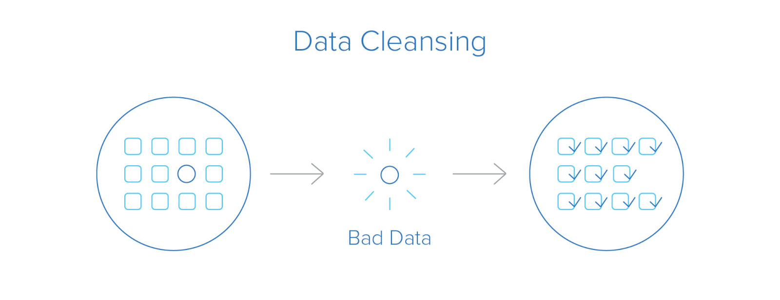
DATA CLEANSING
The corresponding data entries with categories ‘ ’ and ‘Not Applicable’ in Segment/Sub-Segment and ‘0’ in poc_image have been dropped
Data entries having a negligible value (~0) for GTO_2019 and Volume_2019 Product were dropped due to their insignificance from a business perspective
Furthermore, due to mathematical inconsistencies, rows with opposite signs for GTO 2019 and Volume 2019 Product, Tax and GTO 2019 were removed

Slide 7
OUTLIERS AND ANOMALIES
We removed data points having Volume_2019_Product outside the 95 percentile boundary and having a total discount of zero for the classifier as it might lead to poor customer relationships
Fitting a regressor to data points beyond the 95 percentile limit actually caused the model to underperform in the majority of low volume regions
This is due to the model attempting to reduce the error in the high volume area thereby ignoring the low volume points and therefore we excluded these points while training the regressor
We discarded data points having different signs for On/Off-Invoice Discounts and Volume_2019 Product as they are inconsistent
We also removed data points with a discount rate of more than 85% because it seemed unrealistic from a business standpoint

Slide 8
FEATURE SELECTION AND FILTERING
Product Set was dropped as it was a concatenation of 4 features viz. Brand, Sub-brand,Pack_type And Returnability
Due to their high Cramer's Correlation coefficient, Brand and Segment were dropped in favour of Sub-Brand and Sub-Segment, which collected more specific information
Discount_Total was dropped as the target variables were chosen to be its individual constituents (On/Off-Invoice Discount)
Since GTO_2019, Cost_before_tax, Volume_2019_Product and Tax are highly correlated we use only one out of these 4 features. That feature was Cost_before_tax and Volume_2019_Product for Off-Invoice and On-Invoice discount prediction respectively.
Similarly we use Volume_2018 instead of Volume_2019 and Unit Price after Tax instead of Unit Price before Tax to avoid redundant variables
The above feature selection was done based on the model performance on the validation data

Slide 9
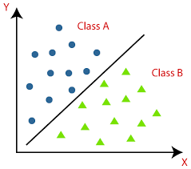
CLASSIFIER
We use the CatBoost classifier for predicting whether a customer is eligible for a discount or not
We use oversampling to account for the class imbalance
We measure the performance using ROC-AUC score and F-beta score where the value of beta is 2 for Off-Invoice and 0.5 for On-Invoice due to higher importance of recall and precision respectively
The hyperparameters are tuned using Randomized Search method

Slide 10
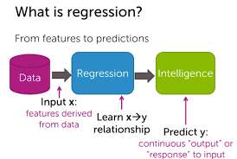
REGRESSOR
We use both LightGBM and CatBoost regressors for predicting the cube root of discount values. This helps to deal with certain very high discount values
First we train both the models using the data points having non-zero discount in the training datasets
Then we tune the hyperparameters of individual models using Randomized Search method
For the final champion model, we use an Ensemble of CatBoost and LightGBM regressor by taking the weighted sum of their predictions
Metrics used for hyperparameter tuning and final evaluation are R Squared and RMSE as these ensure a better overall fit

Slide 11
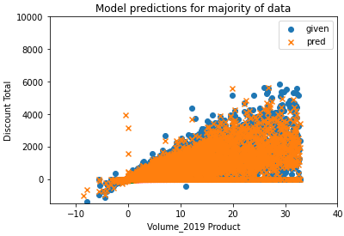
Plot showing the model predictions for majority of the data points

Slide 12

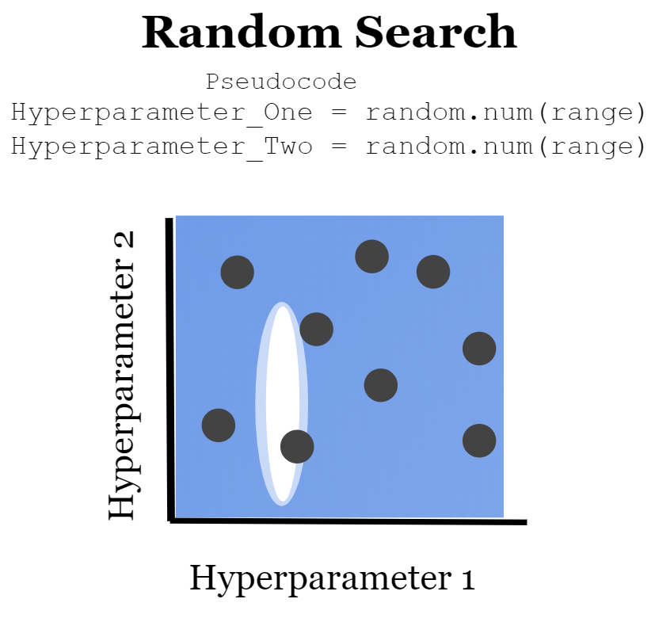
HYPERPARAMETER TUNING AND EVALUATION
We used RandomizedSearchCV for hyperparameter tuning of models. This algorithm trains and evaluates a series of models by taking random draws from a predetermined set of hyperparameter distributions
The algorithm picks the most successful version of the model it has seen after training N different versions of the model with different randomly selected hyperparameter combinations, leaving us with a model trained on a near-optimal set of hyperparameters
We randomly sample 20% of the points from the training data and use them to evaluate our model
The results of the the same are given in the next slide

Slide 13
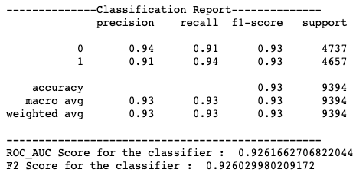
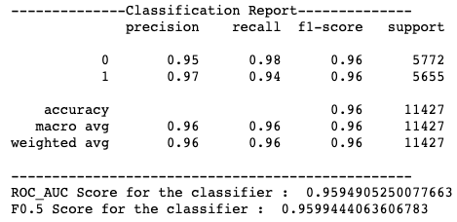


EVALUATION SCORES
Off-Invoice Classifier:
Off-Invoice Regressor:
On-Invoice Classifier:
On-Invoice Regressor:

Slide 14
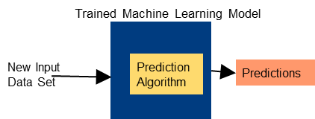
PREDICTIONS ON THE TEST DATASET
All the anomalies dropped during preparation of the training dataset are combined together to create the test dataset
The model is then used to predict the discounts on the test dataset and these predictions are then compared to the actual discounts
The results are presented and analysed in the next five slides

Slide 15
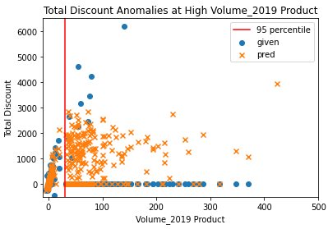
The plot shows the model performance for high Volume_2019 Product ie, for points lying outside the 95 percentile boundary
As is evident, our model recommends non-zero discounts for such points unlike the actual discounts
This is critical for maintaining a good rapport with customers

Slide 16
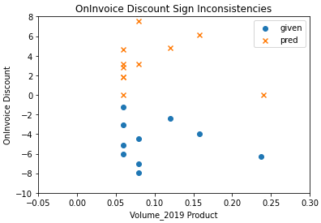
The plot shows the points having opposite signs of Volume_2019 Product and On-Invoice Discount
It depicts the model's ability to resolve the above problem i.e recommend positive discounts for positive Volume_2019 product

Slide 17
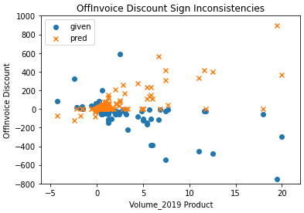
The plot shows the points having opposite signs of Volume_2019 Product and Off-Invoice Discount
It depicts the model's ability to resolve the above problem i.e recommend positive discounts for positive Volume_2019 product and similarly for the negative

Slide 18
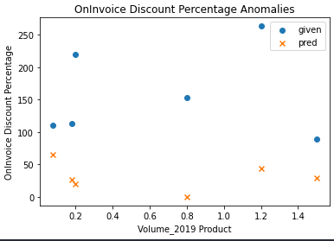
The plot shows points having very high (>85%) On-Invoice Discount percentage
As we can clearly see, our model recommends reasonable On-Invoice discounts unlike the actual values where few of them even exceeded 100%!

Slide 19
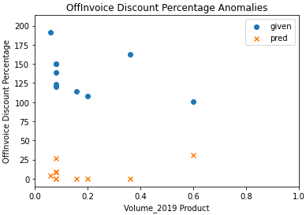
The plot shows points having very high (>85%) Off-Invoice Discount percentage
As we can clearly see, our model recommends reasonable Off-Invoice discounts unlike the actual values where few of them even exceeded 100%!

Slide 20
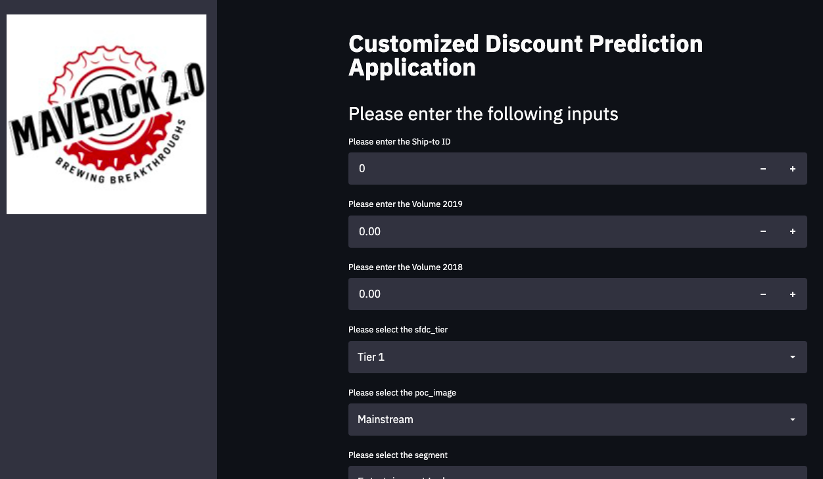
USER INTERFACE
We have used Streamlit, an open-source app framework for Machine Learning and Data Science, to develop the user interface of our discount predictor
This application allows a user to predict the total discount along with its constituents: off-invoice and on-invoice discounts using the saved models in real time

Slide 21
Thank You :)

